Slide 1
Mental Health in the Correctional System
Making Choices for Safety and Well-Being

Slide 2
Mental Disorders and Patients’ Rights
Module 8

Slide 3
Recognizing Mental Disorders

Slide 4
What Causes Mental Disorder?
Notes:
On the next slide the video will play automatically

Slide 5
Rena Changes

Slide 6
Get Help

Slide 7
The Power of Mental Illness

Slide 8
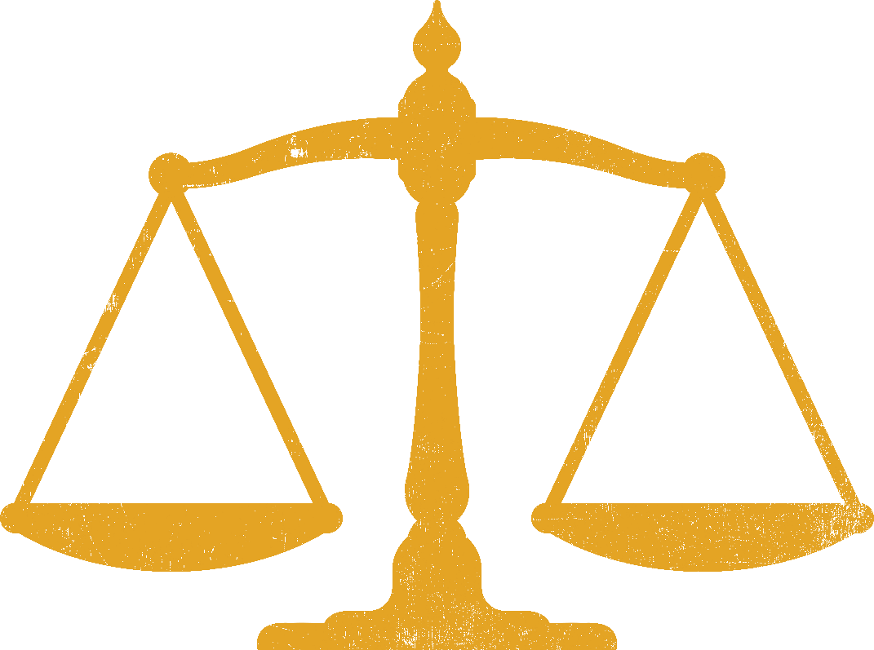
Rights While Incarcerated

Slide 9
Thank You

