Slide 1
Mental Health in the Correctional System
Making Choices for Safety and Well-Being

Slide 2
De-Institutionalization & Criminalization
Module 3

Slide 3
De-Institutionalization

Slide 4
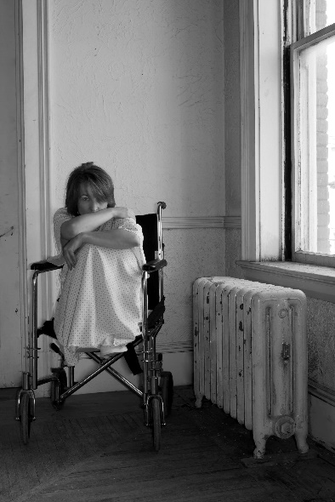
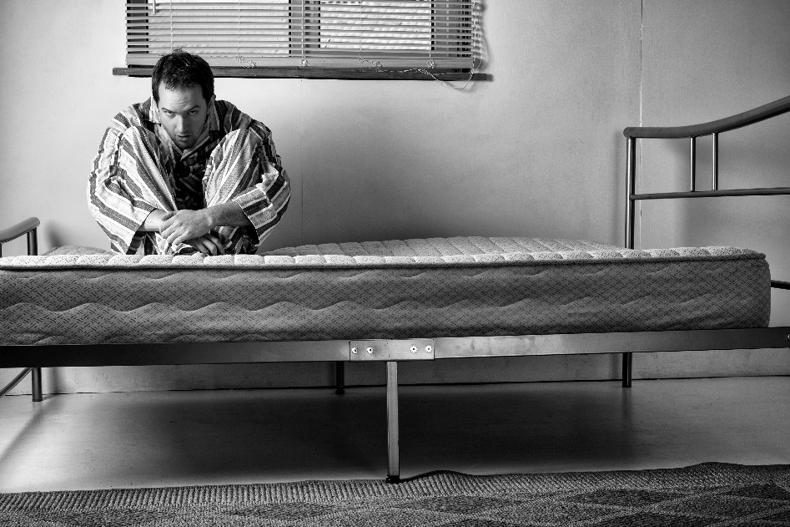
State Mental Hospitals

Slide 5
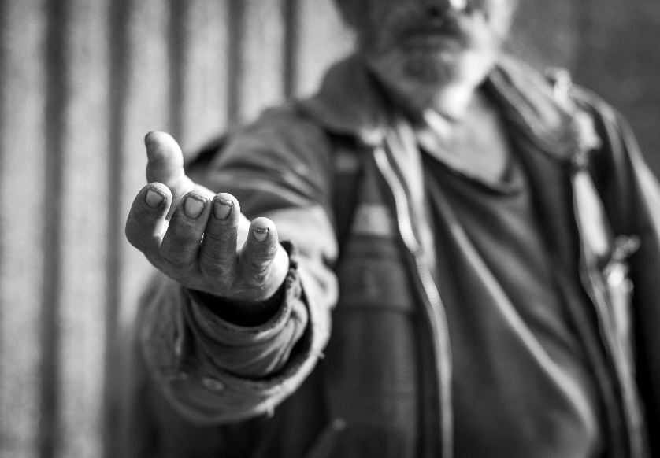
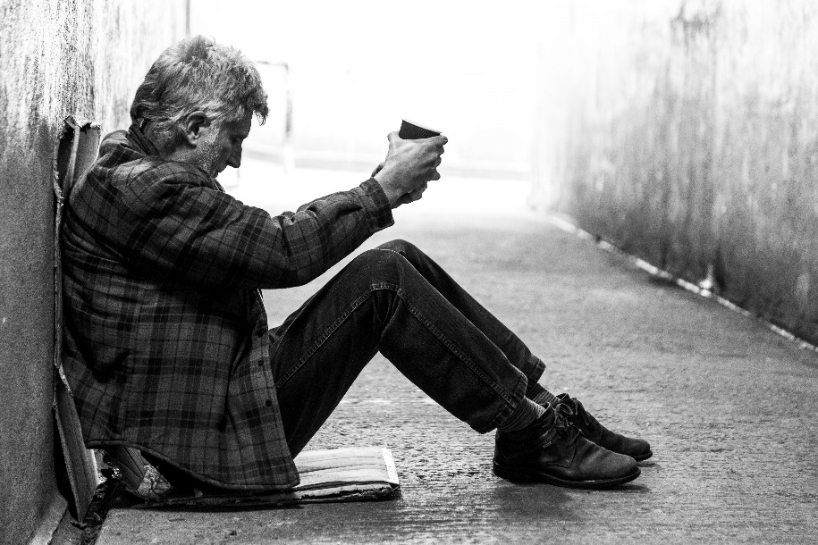
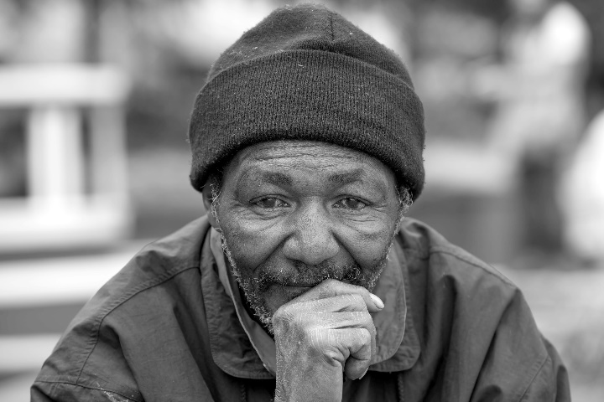
Community care never became the safety net needed

Slide 6
Criminalization

Slide 7
Where did they go?
“In 2004-2005, there were three times more seriously mentally ill people in jails and prisons than in mental hospitals.”

Slide 8
Many are in prison
"America's jails and prisons have become our new mental hospitals."

Slide 9
What have you seen?

Slide 10
Criminalization of Mental Illness and Poverty

Slide 11
Criminalization of Drug Addiction

Slide 12
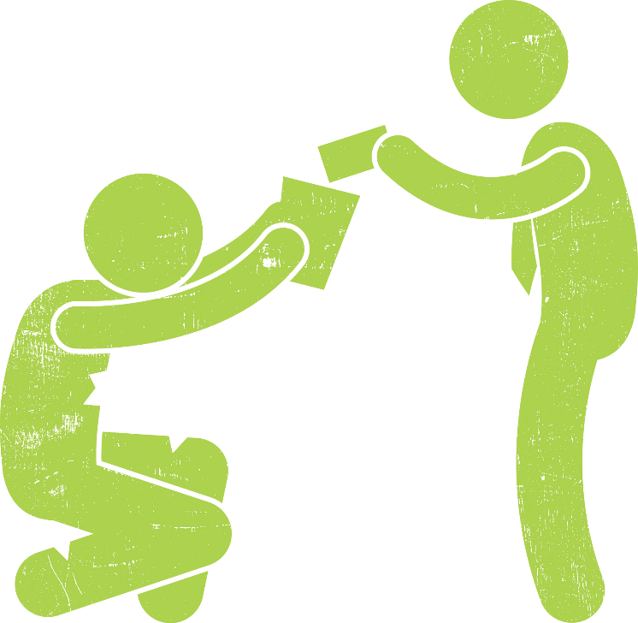
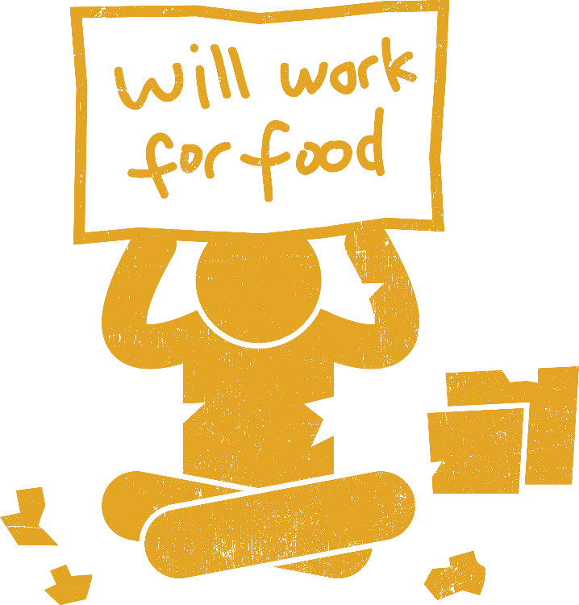
Criminalization of Homelessness

Slide 13
What have you seen?

Slide 14
Connections Between Identity and Incarceration

Slide 15
Targeting Poor and Minority People
African Americans 4 times more likely to be searched than Whites
Begins very young
The “school-to-prison pipeline”
Inability to pay fines
Inability to appear in court

Slide 16
Consequences of Conviction
Increased barriers to:
Employment
Mental health services
Housing
Childcare
Food assistance
Economic services
Transportation

Slide 17
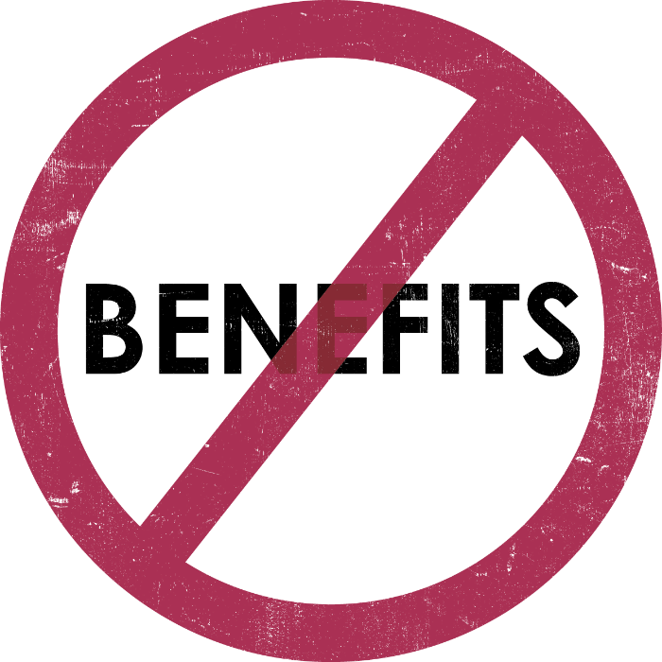
Federal Law Disqualifies Them for Benefits
Forbidden:
Temporary Aid to Needy Families (TANF)
The Supplemental Nutrition Assistance Program (SNAP)
Supplemental Security Income

Slide 18
Complex Histories
Past trauma
Adversity
Mental illness

Slide 19
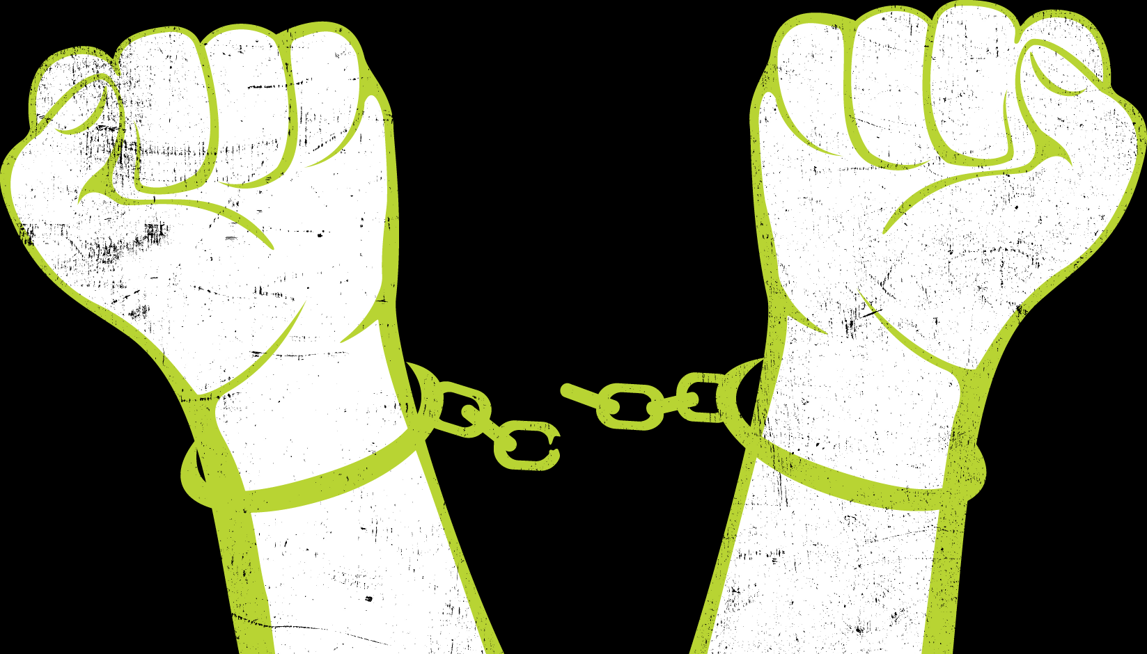
Staying Free
Activity

Slide 20
Activity Instructions
Read your Identity Card carefully.
Stay free of the justice system as long as possible!
If you become justice-involved, hand over your Identity Card to the facilitator.
Decide how your character would handle each challenge as it is read.
Stay within the “world” of the activity by relying only on your Identity Card and not adding details.

Slide 21
You Become Justice-Involved When You:
Become homeless.
Are caught with illegal drugs.
Lose access to medication for a mental health diagnosis.
One criterion is enough!

Slide 22
Givens
These people live in your city or town so all local laws apply.
Challenges are happening sequentially, so they don’t “expire.” They remain in effect.
The local mayor recently declared a crackdown on crime and a “Clean Streets” initiative.

Slide 23
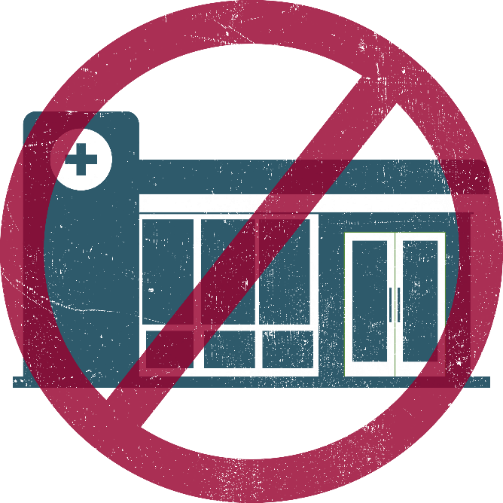
Challenge One
The local free clinic closes. There are no other local alternatives for free or low-cost care and prescription services. If you use the free clinic, you lose access to your medication.

Slide 24
You Become Justice Involved When You:
Become homeless.
Are caught with illegal drugs.
Lose access to medication for a mental health diagnosis.
One criterion is enough!

Slide 25
Challenge Two
As part of the city’s anti-crime initiative, workplaces across town coordinate to have a surprise mandatory drug-screening. If you illegally use drugs regularly and work in a traditional workplace, you test positive and are arrested.

Slide 26
You Become Justice-Involved When You:
Become homeless.
Are caught with illegal drugs.
Lose access to medication for a mental
health diagnosis. One criterion is enough!

Slide 27
Challenge Three
As part of the Clean Streets crackdown, the police institute a stop-and-frisk procedure. If you are from an ethnic minority background (any race or ethnicity other than White) you are stopped. You will be arrested if you have any arrest risk factors (illegal drugs, drunk in public, etc.).

Slide 28
You Become Justice-Involved When You:
Become homeless.
Are caught with illegal drugs.
Lose access to medication for a mental
health diagnosis.
One criterion is enough!

Slide 29
Challenge Four
You have a fight with people you live with. If you don’t own or pay rent on your living space, they throw you out. You must rely on your support network or be homeless.

Slide 30
You Become Justice-Involved When You:
Become homeless.
Are caught with illegal drugs.
Lose access to medication for a mental health diagnosis.
One criterion is enough!

Slide 31
Activity Debrief

Slide 32
Thank You

