Slide 1
Mental Health in the Correctional System
Making Choices for Safety and Well-Being

Slide 2
Promising Practices in Corrections & Re-entry
Module 19

Slide 3
Intercepting Early

Slide 4
The Future is Near: Promising Practices in Corrections

Slide 5
New Maps
Activity

Slide 6
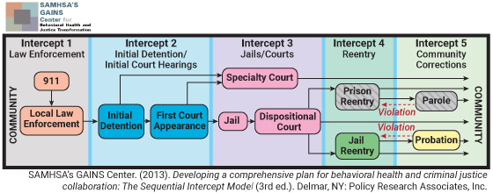
The Sequential Intercept Model in the Community

Slide 7
Activity Debrief

Slide 8
Imagining the Future

Slide 9
Thank You

