Slide 1
Mental Health in the Correctional System
Making Choices for Safety and Well-Being

Slide 2
Understanding Trauma
Module 15

Slide 3
What is Trauma?
Notes:
On the next slide the video will play automatically

Slide 4
Trauma and the Brain

Slide 5
Trauma and Offending

Slide 6
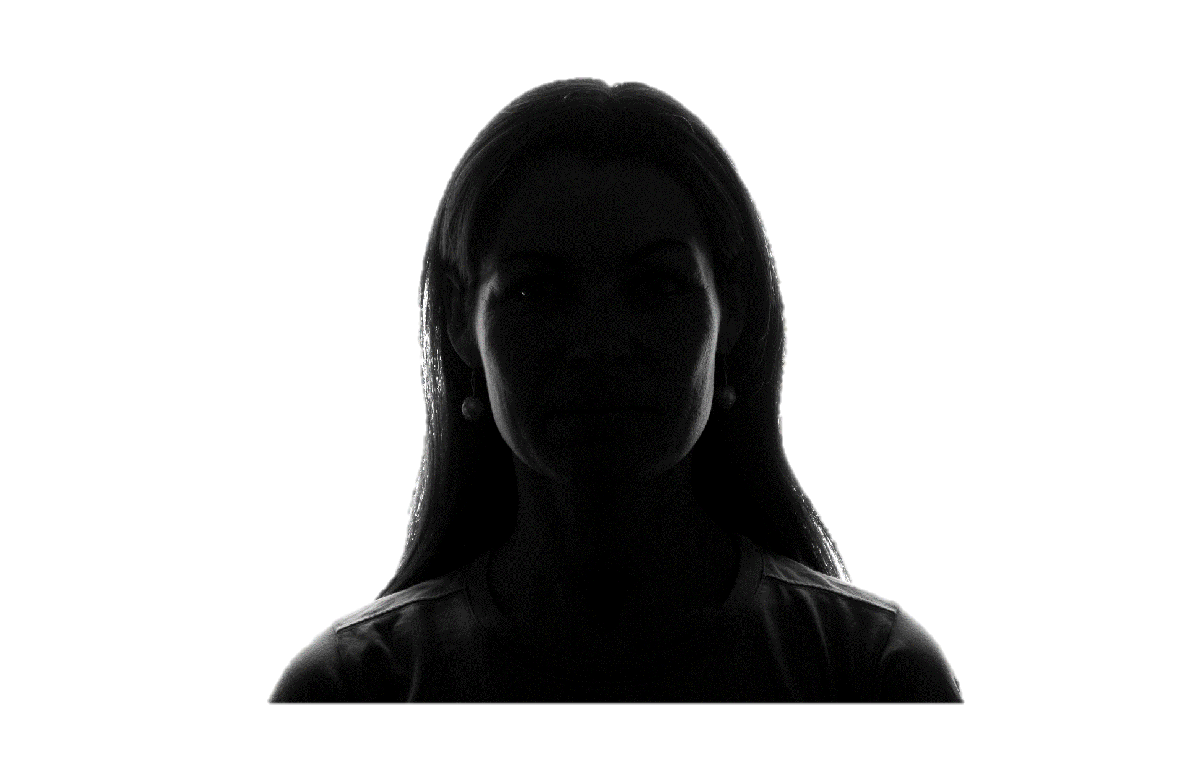
Women and Girls

Slide 7
Men and Boys

Slide 8
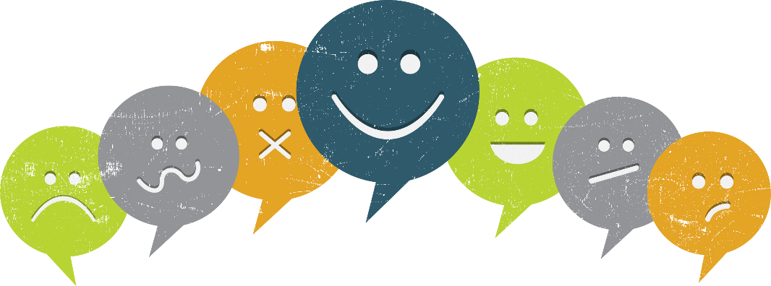
Behavior During Incarceration

Slide 9
Triggers

Slide 10
Definition
A "trigger" is an internal or external experience that reminds a person of past traumatic events. When a trigger is present, the person's mind and body may react as if a threat is present.”

Slide 11
Trauma Triggers in Prison

Slide 12
Remember the Stakes
Notes:
On the next slide the video will play automatically

Slide 13
Raymond Smith: Prison and Trauma

Slide 14
Trauma is Important

Slide 15
Thank You

