Slide 1
Mental Health in the Correctional System
Making Choices for Safety and Well-Being

Slide 2
Mental Health Screening
Module 10

Slide 3
The Importance of Screening

Slide 4
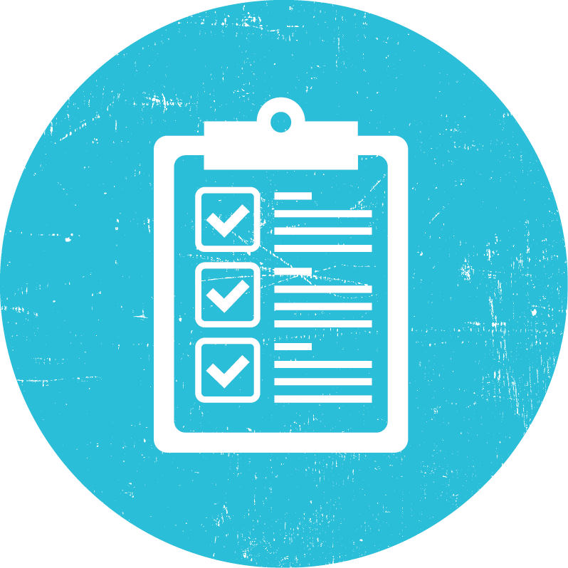
A Screening Tool for Corrections

Slide 5
When and How to Screen

Slide 6
Get Screened
Activity

Slide 7
Instructions
Pick a partner
Review the screening tool
Wait for the facilitator before you begin

Slide 8
Screening Best Practices
Conduct in private
At least out of earshot of any other people
Use a professional, respectful, and calm demeanor
Use an empathetic tone
Be aware of your body language and pace of speech
Findings MUST remain confidential
Share ONLY with mental health or medical staff
Report findings within 24 hours

Slide 9
Thank You

